Slide 1
Algorithms
Graph Searching Techniques
Topological Sorting

Slide 2
Graph Searching
Given: a graph G = (V, E), directed or undirected
Goal: methodically explore every vertex and every edge
Ultimately: build a tree on the graph
Pick a vertex as the root
Choose certain edges to produce a tree
Note: might also build a forest if graph is not connected
There are two standard graph traversal techniques:
Breadth-First Search (BFS)
Depth-First Search (DFS)

Slide 3
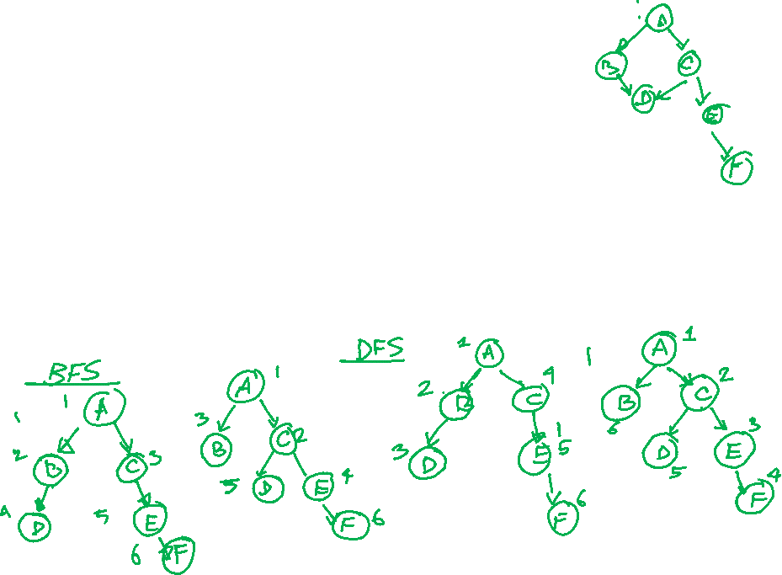
Breadth-First Search
“Explore” a graph, turning it into a tree
One vertex at a time
Expand frontier of explored vertices across the breadth of the frontier
Builds a tree over the graph
Pick a source vertex to be the root
Find (“discover”) its children, then their children, etc.

Slide 4
Breadth-First Search
Again will associate vertex “colors” to guide the algorithm
White vertices have not been discovered
All vertices start out white
Grey vertices are discovered but not fully explored
They may be adjacent to white vertices
Black vertices are discovered and fully explored
They are adjacent only to black and grey vertices
Explore vertices by scanning adjacency list of grey vertices

Slide 5
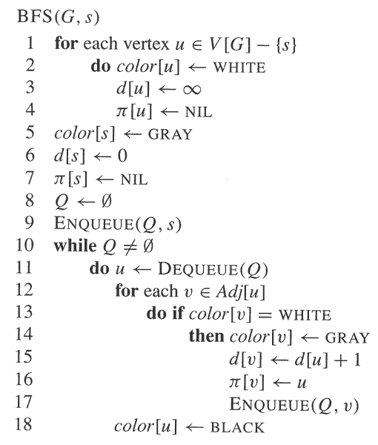
Breadth-First Search

Slide 6
Breadth-First Search: Example
r
s
t
u
∞
∞
∞
∞
∞
∞
∞
∞
v
w
x
y

Slide 7
Breadth-First Search: Example
r
s
t
u
∞
0
∞
∞
∞
∞
∞
∞
v
w
x
y
Q:
s

Slide 8
Breadth-First Search: Example
r
s
t
u
1
0
∞
∞
∞
1
∞
∞
v
w
x
y
Q:
w
r

Slide 9
Breadth-First Search: Example
r
s
t
u
1
0
2
∞
∞
1
2
∞
v
w
x
y
Q:
r
t
x

Slide 10
Breadth-First Search: Example
r
s
t
u
1
0
2
∞
2
1
2
∞
v
w
x
y
Q:
t
x
v

Slide 11
Breadth-First Search: Example
r
s
t
u
1
0
2
3
2
1
2
∞
v
w
x
y
Q:
x
v
u

Slide 12
Breadth-First Search: Example
r
s
t
u
1
0
2
3
2
1
2
3
v
w
x
y
Q:
v
u
y

Slide 13
Breadth-First Search: Example
r
s
t
u
1
0
2
3
2
1
2
3
v
w
x
y
Q:
u
y

Slide 14
Breadth-First Search: Example
r
s
t
u
1
0
2
3
2
1
2
3
v
w
x
y
Q:
y

Slide 15
Breadth-First Search: Example
r
s
t
u
1
0
2
3
2
1
2
3
v
w
x
y
Q:
Ø

Slide 16
BFS - A Graphical Representation
a)
b)
c)
d)

Slide 17
BFS - A Graphical Representation
e)
f)

Slide 18
BFS: The Code Again
BFS(G, s) {
initialize vertices;
Q = {s};
while (Q not empty) {
u = RemoveTop(Q);
for each v ∈ u->adj {
if (v->color == WHITE)
v->color = GREY;
v->d = u->d + 1;
v->p = u;
Enqueue(Q, v);
}
u->color = BLACK;
}
}
Touch every vertex: O(V)
u = every vertex, but only once (Why?)
So v = every vertex that appears in some other vert’s adjacency list
What will be the running time?
Total running time: O(V+E)

Slide 19
BFS: The Code Again
BFS(G, s) {
initialize vertices;
Q = {s};
while (Q not empty) {
u = RemoveTop(Q);
for each v ∈ u->adj {
if (v->color == WHITE)
v->color = GREY;
v->d = u->d + 1;
v->p = u;
Enqueue(Q, v);
}
u->color = BLACK;
}
}
What will be the storage cost
in addition to storing the tree?
Total space used: O(V + Σ(degree(v))) = O(V + E)

Slide 20
Breadth-First Search : Disconnected Graph
BFS_Visit(u)
u->color = GREY;
u->d = 0
u->π = NIL
Q = φ;
Enqueue(Q, u)
while Q ≠ φ
u = Dequeue(Q)
for each v ∈ u->Adj[u]
if (v->color == WHITE)
v->color = GREY;
v->d = u->d + 1
v->π = u
Enqueue(Q, v)
u->color = BLACK;
BFS(G)
for each vertex u ∈ G->V
u->color = WHITE;
u->d = ∝
u->π = NIL
for each vertex u ∈ G->V
if (u->color == WHITE)
BFS_Visit(u);

Slide 21
Breadth-First Search : Disconnected Graph
r
s
t
u
∞
∞
∞
∞
∞
∞
∞
∞
v
w
x
y

Slide 22
Breadth-First Search : Disconnected Graph
r
s
t
u
∞
0
∞
∞
∞
∞
∞
∞
v
w
x
y
Q:
s

Slide 23
Breadth-First Search : Disconnected Graph
r
s
t
u
1
0
∞
∞
1
1
∞
∞
v
w
x
y
Q:
w
r
v

Slide 24
Breadth-First Search : Disconnected Graph
r
s
t
u
1
0
∞
∞
1
1
∞
∞
v
w
x
y
Q:
r
v

Slide 25
Breadth-First Search : Disconnected Graph
r
s
t
u
1
0
∞
∞
1
1
∞
∞
v
w
x
y
Q:
v

Slide 26
Breadth-First Search : Disconnected Graph
r
s
t
u
1
0
∞
∞
1
1
∞
∞
v
w
x
y
Q:
Ø

Slide 27
Breadth-First Search : Disconnected Graph
r
s
t
u
1
0
0
∞
1
1
∞
∞
v
w
x
y
Q:
t

Slide 28
Breadth-First Search : Disconnected Graph
r
s
t
u
1
0
0
1
1
1
1
∞
v
w
x
y
Q:
u
x

Slide 29
Breadth-First Search : Disconnected Graph
r
s
t
u
1
0
0
1
1
1
1
2
v
w
x
y
Q:
x
y

Slide 30
Breadth-First Search : Disconnected Graph
r
s
t
u
1
0
0
1
1
1
1
2
v
w
x
y
Q:
y

Slide 31
Breadth-First Search : Disconnected Graph
r
s
t
u
1
0
0
1
1
1
1
2
v
w
x
y
Q:
Ø

Slide 32
Breadth-First Search: Properties
BFS calculates the shortest-path distance to the source node
Shortest-path distance δ(s, v) = minimum number of edges from s to v, or ∞ if v not reachable from s
BFS builds breadth-first tree (forest), in which paths to root(s) represent shortest paths in G
Thus can use BFS to calculate shortest path from one vertex to another in O(V + E) time in an unweighted tree

Slide 33
Depth-First Search
Depth-first search is another strategy for exploring a graph
Explore “deeper” in the graph whenever possible
Edges are explored out of the most recently discovered vertex v that still has unexplored edges
When all of v’s edges have been explored, backtrack to the vertex from which v was discovered
Vertices initially colored white
Then colored grey when discovered
Then black when finished

Slide 34
Depth-First Search: The Code
DFS(G)
for each vertex u ∈ G->V
u->color = WHITE
u-> π = NIL
time = 0;
for each vertex u ∈ G->V
if (u->color == WHITE)
DFS_Visit(u)
DFS_Visit(u)
u->color = GREY
time = time+1
u->d = time
for each v ∈ u->Adj[]
if (v->color == WHITE)
v -> π = u
DFS_Visit(v)
u->color = BLACK
time = time+1
u->f = time

Slide 35
Depth-First Search: The Code
DFS(G)
{
for each vertex u ∈ G->V
{
u->color = WHITE;
}
time = 0;
for each vertex u ∈ G->V
{
if (u->color == WHITE)
DFS_Visit(u);
}
}
DFS_Visit(u)
{
u->color = GREY;
time = time+1;
u->d = time;
for each v ∈ u->Adj[]
{
if (v->color == WHITE)
DFS_Visit(v);
}
u->color = BLACK;
time = time+1;
u->f = time;
}
What does u->d represent?

Slide 36
Depth-First Search: The Code
DFS(G)
{
for each vertex u ∈ G->V
{
u->color = WHITE;
}
time = 0;
for each vertex u ∈ G->V
{
if (u->color == WHITE)
DFS_Visit(u);
}
}
DFS_Visit(u)
{
u->color = GREY;
time = time+1;
u->d = time;
for each v ∈ u->Adj[]
{
if (v->color == WHITE)
DFS_Visit(v);
}
u->color = BLACK;
time = time+1;
u->f = time;
}
What does u->f represent?

Slide 37
Depth-First Search: The Code
DFS(G)
{
for each vertex u ∈ G->V
{
u->color = WHITE;
}
time = 0;
for each vertex u ∈ G->V
{
if (u->color == WHITE)
DFS_Visit(u);
}
}
DFS_Visit(u)
{
u->color = GREY;
time = time+1;
u->d = time;
for each v ∈ u->Adj[]
{
if (v->color == WHITE)
DFS_Visit(v);
}
u->color = BLACK;
time = time+1;
u->f = time;
}
Will all vertices eventually be colored black?

Slide 38
Depth-First Search: The Code
DFS(G)
{
for each vertex u ∈ G->V
{
u->color = WHITE;
}
time = 0;
for each vertex u ∈ G->V
{
if (u->color == WHITE)
DFS_Visit(u);
}
}
DFS_Visit(u)
{
u->color = GREY;
time = time+1;
u->d = time;
for each v ∈ u->Adj[]
{
if (v->color == WHITE)
DFS_Visit(v);
if (v->color == GREY)
print(this is a backedge)
}
u->color = BLACK;
time = time+1;
u->f = time;
}
What will be the running time?

Slide 39
Depth-First Search: The Code
DFS(G)
{
for each vertex u ∈ G->V
{
u->color = WHITE;
}
time = 0;
for each vertex u ∈ G->V
{
if (u->color == WHITE)
DFS_Visit(u);
}
}
DFS_Visit(u)
{
u->color = GREY;
time = time+1;
u->d = time;
for each v ∈ u->Adj[]
{
if (v->color == WHITE)
DFS_Visit(v);
}
u->color = BLACK;
time = time+1;
u->f = time;
}
Running time: O(n²) because call DFS_Visit on each vertex, and the loop over Adj[] can run as many as |V| times

Slide 40
Depth-First Search: The Code
DFS(G)
{
for each vertex u ∈ G->V
{
u->color = WHITE;
}
time = 0;
for each vertex u ∈ G->V
{
if (u->color == WHITE)
DFS_Visit(u);
}
}
DFS_Visit(u)
{
u->color = GREY;
time = time+1;
u->d = time;
for each v ∈ u->Adj[]
{
if (v->color == WHITE)
DFS_Visit(v);
}
u->color = BLACK;
time = time+1;
u->f = time;
}
BUT, there is actually a tighter bound. How many times will DFS_Visit() actually be called?

Slide 41
Depth-First Search: The Code
DFS(G)
{
for each vertex u ∈ G->V
{
u->color = WHITE;
}
time = 0;
for each vertex u ∈ G->V
{
if (u->color == WHITE)
DFS_Visit(u);
}
}
DFS_Visit(u)
{
u->color = GREY;
time = time+1;
u->d = time;
for each v ∈ u->Adj[]
{
if (v->color == WHITE)
DFS_Visit(v);
}
u->color = BLACK;
time = time+1;
u->f = time;
}
So, running time of DFS = O(V+E)

Slide 42
Depth-First Search Analysis
This running time argument is an informal example of amortized analysis
“Charge” the exploration of edge to the edge:
Each loop in DFS_Visit can be attributed to an edge in the graph
Runs once/edge if directed graph, twice if undirected
Thus loop will run in O(E) time, algorithm O(V + E)
Storage requirement is O(V + E), since adjacent list requires O(V + E) storage

Slide 43
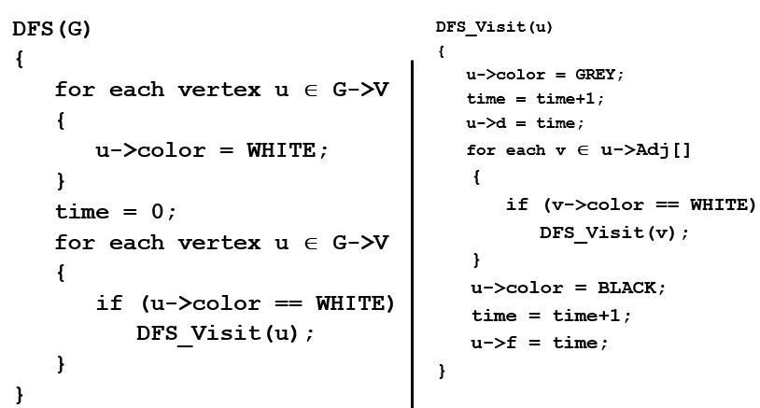
DFS Example
source vertex

Slide 44
DFS Example
source vertex
d f
1 |
|
|
|
|
|
|
|

Slide 45
DFS Example
source vertex
d f
1 |
|
|
2 |
|
|
|
|

Slide 46
DFS Example
source vertex
d f
1 |
|
|
2 |
|
3 |
|
|

Slide 47
DFS Example
source vertex
d f
1 |
|
|
2 |
|
3 | 4
|
|

Slide 48
DFS Example
source vertex
d f
1 |
|
|
2 |
|
3 | 4
5 |
|

Slide 49
DFS Example
source vertex
d f
1 |
|
|
2 |
|
3 | 4
5 | 6
|

Slide 50
DFS Example
source vertex
d f
1 |
8 |
|
2 | 7
|
3 | 4
5 | 6
|

Slide 51
DFS Example
source vertex
d f
1 |
8 |
|
2 | 7
|
3 | 4
5 | 6
|

Slide 52
DFS Example
source vertex
d f
1 |
8 |
|
2 | 7
9 |
3 | 4
5 | 6
|

Slide 53
DFS Example
source vertex
d f
1 |
8 |
|
2 | 7
9 |10
3 | 4
5 | 6
|

Slide 54
DFS Example
source vertex
d f
1 |
8 |11
|
2 | 7
9 |10
3 | 4
5 | 6
|

Slide 55
DFS Example
source vertex
d f
1 |12
8 |11
|
2 | 7
9 |10
3 | 4
5 | 6
|

Slide 56
DFS Example
source vertex
d f
1 |12
8 |11
13|
2 | 7
9 |10
3 | 4
5 | 6
|

Slide 57
DFS Example
source vertex
d f
1 |12
8 |11
13|
2 | 7
9 |10
3 | 4
5 | 6
14|

Slide 58
DFS Example
source vertex
d f
1 |12
8 |11
13|
2 | 7
9 |10
3 | 4
5 | 6
14|15

Slide 59
DFS Example
source vertex
d f
1 |12
8 |11
13|16
2 | 7
9 |10
3 | 4
5 | 6
14|15

Slide 60
DFS: Kinds of edges
DFS introduces an important distinction among edges in the original graph:
Tree edge: encounter new (white) vertex
The tree edges form a spanning forest
Can tree edges form cycles? Why or why not?

Slide 61
DFS: Kinds of edges
source vertex
d f
1 |12
8 |11
13|16
2 | 7
9 |10
3 | 4
5 | 6
14|15
Tree edges

Slide 62
DFS: Kinds of edges
DFS introduces an important distinction among edges in the original graph:
Tree edge: encounter new (white) vertex
Back edge: from descendent to ancestor
Encounter a grey vertex (grey to grey)

Slide 63
DFS: Kinds of edges
source vertex
d f
1 |
|
|
2 |
|
3 |
|
|
Tree edges
Back edges

Slide 64
DFS: Kinds of edges
DFS introduces an important distinction among edges in the original graph:
Tree edge: encounter new (white) vertex
Back edge: from descendent to ancestor
Forward edge: from ancestor to descendent
Not a tree edge, though
From grey node to black node

Slide 65
DFS: Kinds of edges
source vertex
d f
1 |
8 |
|
2 | 7
|
3 | 4
5 | 6
|
Tree edges
Back edges
Forward edges

Slide 66
DFS: Kinds of edges
DFS introduces an important distinction among edges in the original graph:
Tree edge: encounter new (white) vertex
Back edge: from descendent to ancestor
Forward edge: from ancestor to descendent
Cross edge: between a tree or subtrees
From a grey node to a black node

Slide 67
DFS: Kinds of edges
source vertex
d f
1 |12
8 |11
13|16
2 | 7
9 |10
3 | 4
5 | 6
14|15
Tree edges
Back edges
Forward edges
Cross edges

Slide 68
DFS: Kinds of edges
DFS introduces an important distinction among edges in the original graph:
Tree edge: encounter new (white) vertex
Back edge: from descendent to ancestor
Forward edge: from ancestor to descendent
Cross edge: between a tree or subtrees
Note: tree and back edges are very important; some algorithms use forward and cross edges

Slide 69
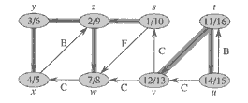
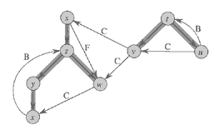
DFS: Kinds of edges

Slide 70
Directed Acyclic Graphs
A directed acyclic graph or DAG is a directed graph with no directed cycles

Slide 71
Topological Sort
A topological sort of a DAG is
a linear ordering of all vertices of the graph G such that vertex u comes before vertex v if (u, v) is an edge in G.
DAG indicates precedence among events:
events are graph vertices, edge from u to v means event u has precedence over event v
Real-world example:
getting dressed
course registration
tasks for eating meal

Slide 72
Precedence Example
Tasks that have to be done to eat breakfast:
get glass, pour juice, get bowl, pour cereal, pour milk, get spoon, eat.
Certain events must happen in a certain order (ex: get bowl before pouring milk)
For other events, it doesn't matter (ex: get bowl and get spoon)
Notes:
72

Slide 73
Precedence Example
get glass
get bowl
pour juice
pour cereal
get spoon
pour milk
eat breakfast
Order: glass, juice, bowl, cereal, milk, spoon, eat.
73
Notes:
73

Slide 74
Why Acyclic?
Why must directed graph by acyclic for the topological sort problem?
Otherwise, no way to order events linearly without violating a precedence constraint.
74
Notes:
74

Slide 75
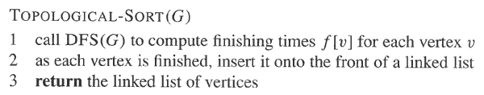
Topological Sort Algorithm
Time: O(V + E)
Correctness: Want to prove that (u, v) ∈ E(G) ⇒ f (u) > f (v)
75
Notes:
75

Slide 76
Topological Sort: Another Algorithm
v₂
v₃
v₆
v₅
v₄
v₇
v₁
v₁
Topological order:

Slide 77
Topological Sort: Another Algorithm
v₂
v₂
v₃
v₆
v₅
v₄
v₇
Topological order: v₁

Slide 78
Topological Sort: Another Algorithm
v₃
v₃
v₆
v₅
v₄
v₇
Topological order: v₁, v₂

Slide 79
Topological Sort: Another Algorithm
v₆
v₅
v₄
v₄
v₇
Topological order: v₁, v₂, v₃

Slide 80
Topological Sort: Another Algorithm
v₆
v₅
v₅
v₇
Topological order: v₁, v₂, v₃, v₄

Slide 81
Topological Sort: Another Algorithm
v₆
v₆
v₇
Topological order: v₁, v₂, v₃, v₄, v₅

Slide 82
Topological Sort: Another Algorithm
v₇
v₇
Topological order: v₁, v₂, v₃, v₄, v₅, v₆

Slide 83
Topological Sort: Another Algorithm
v₂
v₃
v₆
v₅
v₄
v₁
v₂
v₃
v₄
v₅
v₆
v₇
v₇
v₁
Topological order: v₁, v₂, v₃, v₄, v₅, v₆, v₇.

